Slide 1


Digital Tracking of Electrical Current Transducers Solution (DTECTS) continuous commissioning and fault detection for electric motor & power assets
M&V Services
ergsense.com
11/01/2016

Slide 2
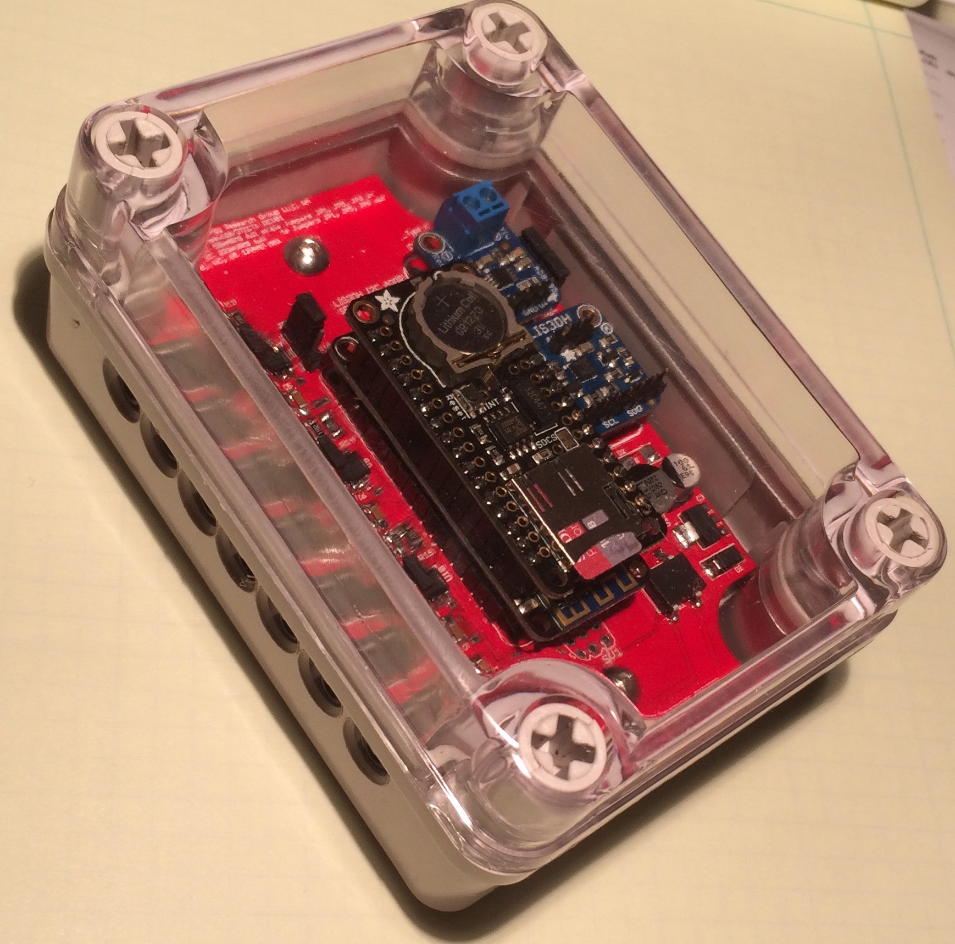
DTECTS, An Introduction
The Value of Continuous Commissioning, Collecting Motor Op Data and Analytics
The DTECTS System
DTECTS Sample Reports
DTECTS Target Availability and Pricing

Slide 3
What If?
You could…
Avoid unscheduled truck rolls and reduce your warranty costs while raising profit.
Prevent your customers from experiencing ‘surprise’ business interruptions.
Build a database of what really does and does not work to expectations for your customers.
Partner with your customers in energy saving programs.
All without the high cost associated with the “Big 3” Building Automation suppliers!
Schneider Electric, Johnson Controls, Siemens
You can…
With High Frequency Motor Operational Monitoring from ergsense via the DTECTS System
Read on…

Slide 4
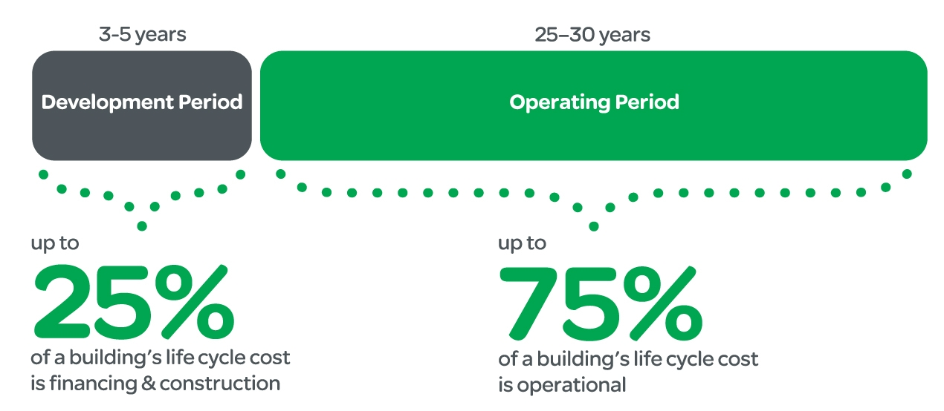
The Value of Continuous Commissioning
Once Commissioned (Install, setup, verify & leave) an asset like HVAC or a refrigeration plant will generally begin to fall off its ideal efficiency curve immediately.
Over time, the use and occupancy modes for a building will change, leaving the HVAC and Refrigeration systems to operate at less than ideal efficiencies
Studies by the US DOE show that once commissioned, building efficiency will degrade up to 15% per year
Continuous Commissioning is like having a trained HVAC tech on site 24/7 to measure the operational parameters of your managed asset so that you can suggest money saving changes to your customer
Well Defined
Changing use models and aging assets

Slide 5
The Value of Motor Operational Parameters
Electric Motors are the heart of any Pumping, HVAC and Refrigeration System
90% or more of the Electrical Energy for a system is consumed by its motors
If a motor fails, the system fails
Operational Parameters are Valuable Indicators
If we could monitor the three key operational parameters of a motor:
Phase Current – Are the starting and running loads on the motor changing? Is the operational period deviating from nominal?
Motor temperature – Is the running load or the environment driving the motor temperature up or down?
Motor Vibration – Are loads becoming ‘frozen’ or are bearings failing?
Then we would know how the system is performing relative to its ratings and more importantly to its past operation
Analytics simplifies complex data for decision making…

Slide 6
The Value of Analytics
To be useful for more than simple energy use reporting on a 15 minute granularity (PanoramicPower and others do this), Operational Parameters need to be sampled at a high rate of speed and with high resolution.
Getting this data out of the system in a secure manner would be costly and time consuming.
Truck Roll to pick up and download the data into a PC
Cellular Data Connection for GB of data per day
It would be time prohibitive for even the most skilled HVAC tech to wade through the huge amount of data generated in order to make a decision or even reliably recognize a fault.
Data Analytics applies expert knowledge of how motors in HVAC should work, coupled with statistical data trending and tracking to build operational alarms.
Data Bandwidth is cut by many orders of magnitude meaning that cellular data connections are cost effective and facilities IT departments are not involved
You know immediately when a motor asset is drifting too far out of its nominal operational parameters
You still get the normal M&V energy reports based on AC phase current and nominal voltage

Slide 7
The DTECT Solution HW & SW
DTECTS – Digital Tracking of Electrical Current Transducers Solution
Industrial grade microprocessor based measurement and telemetry sensor connected to an electrical motor without disconnection of power supply
Powerful 32 bit micro controller with WiFi networking
Three Phase Energy Sensing inputs for Voltage and Current using standard transducers
Integrated surface (IR) temperature. 3 axis vibration and position sensors with optional external thermocouple
Magnetic mount to motor & has optional mounting flanges for application to non magnetic surfaces
Comprehensive SW supports
Easy Installation
Operational Performance tracking & trending reports on demand
User adjustable alarms and actions (email, SMS)

Slide 8
Cloud Connection
WiFi connection to premise LAN then to Ergsense cloud analytics
Optional Industrial grade microprocessor based cellular (CDMA in US) data processing gateway
Manages several DTECTS sensors
Connected to sensors by USB or WiFi
Carrier approved cellular modem
User supplied SIM
Connects data to the ergsense cloud
Cloud.ergsense.com* data analytics and user portal
Secure data storage and connections
Convenient and easy to use reports on operation, energy use and predictive failure
Email and SMS alarm alerts for out of bounds operational parameters
* not live at this date

Slide 9
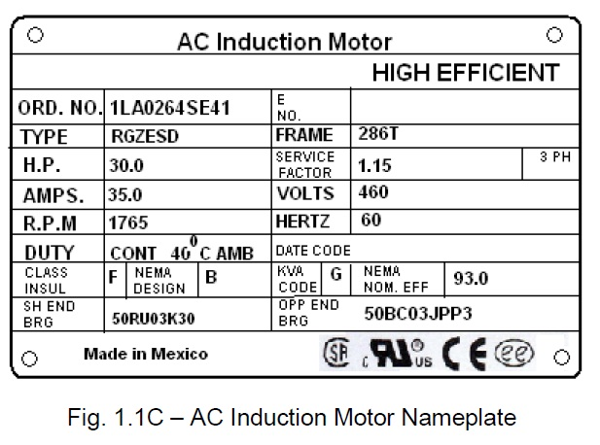


DTECTS System Diagram
starter
CTs
VTs
Motor
3ph
1ph AC
DTECTS Platform
DTECTS
Temp
&
vibration
=
cloud.ergsense.com*
PS
Analog Front End
PMIC
Controller
w/ RTC
WiFi
DTECTS Analytics
eMMC
Mount DTECTS & connect CT and power
Join the DTECTS network to setup the device with your network credentials then reconnect to your LAN
On your browser, login to your DTECTS and complete the setup.
Sync locally to capture latest data – or -
Access cloud.ergsense.com to observe your data trends.
* Not live at this date
LAN

Slide 10
DTECTS Prototype Reports
Prototypes, actual product will vary

Slide 11
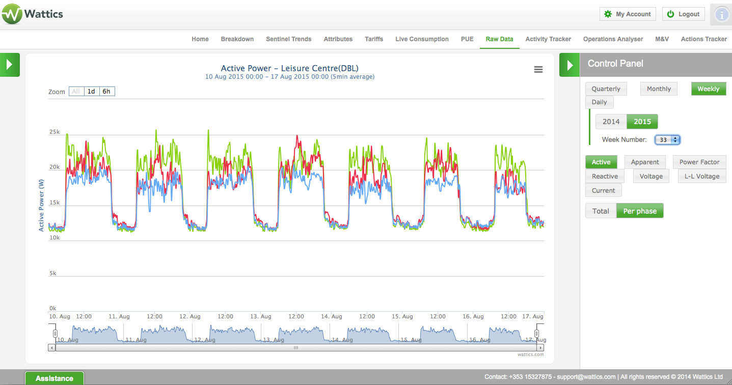
Weekly Operational View

Slide 12
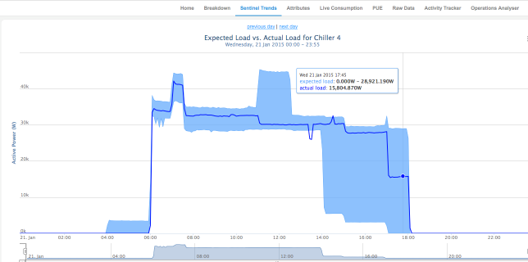
Daily Operational View

Slide 13
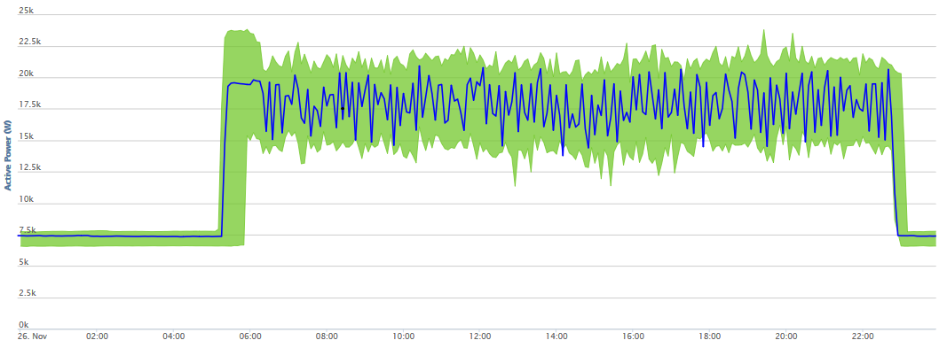
Hourly Operational View

Slide 14
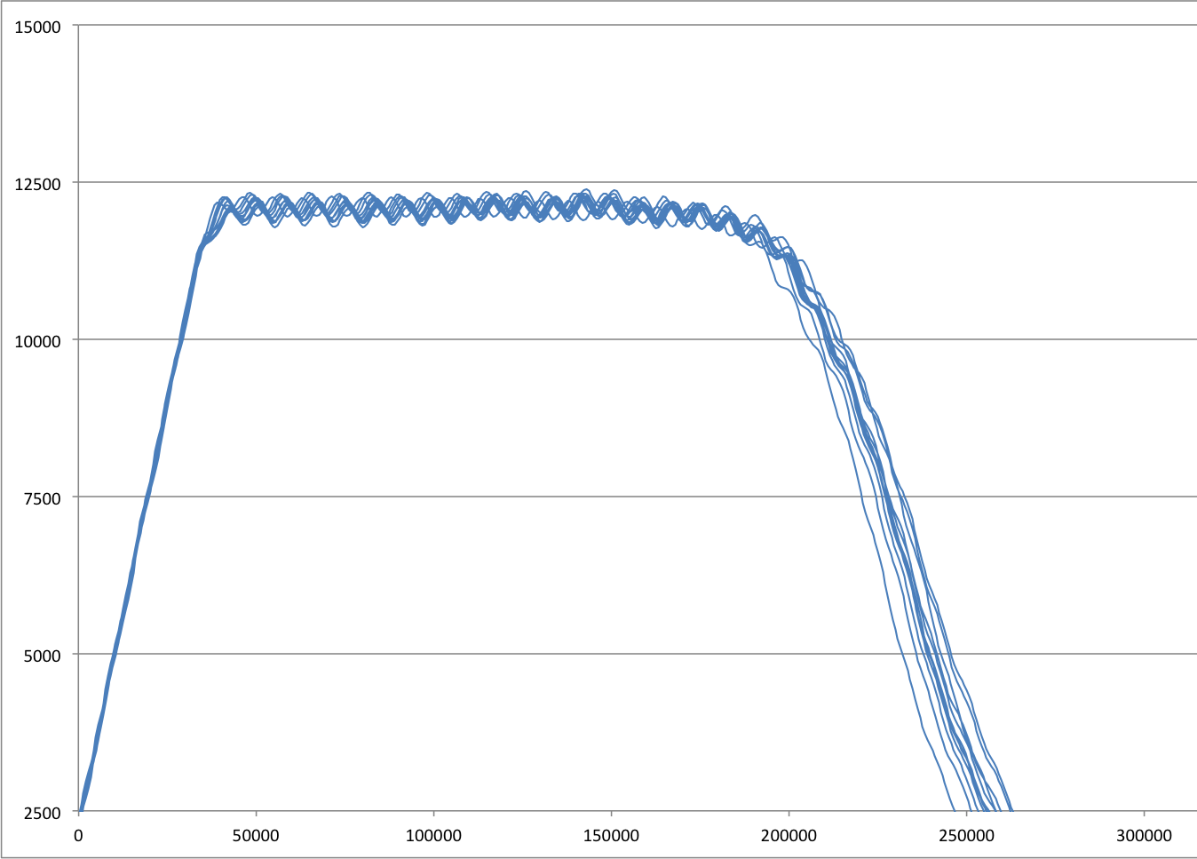
Instantaneous Performance View
Process limit
Inrush Power (Watts)
Time (microseconds)

